Slide 1
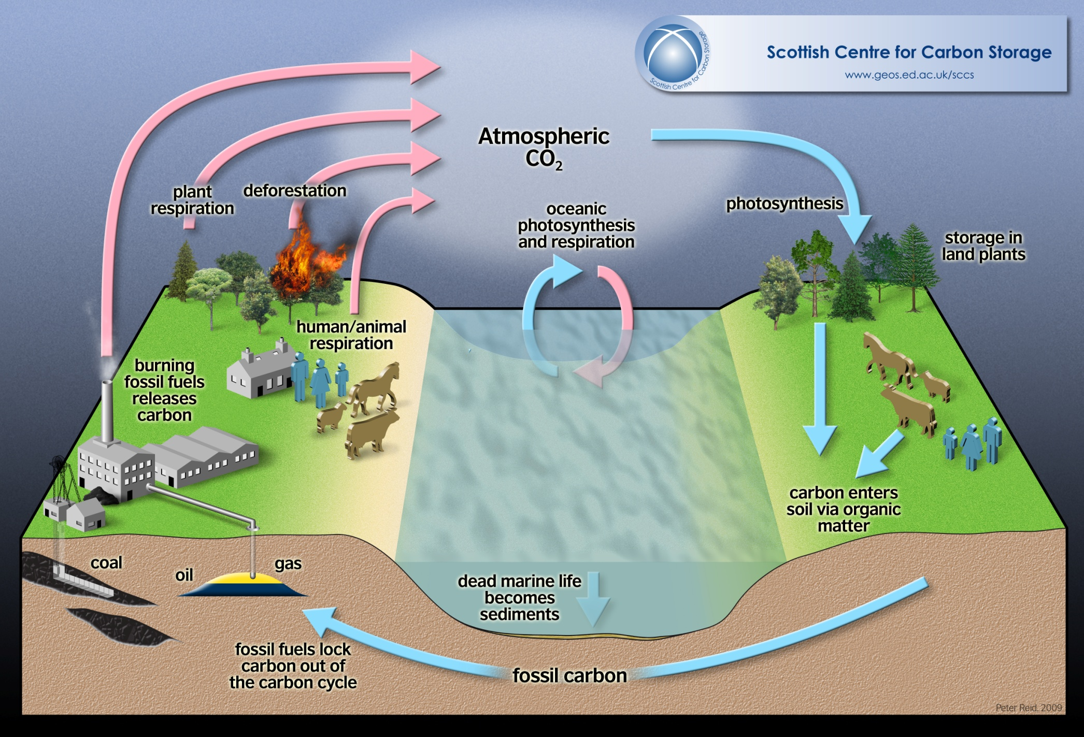
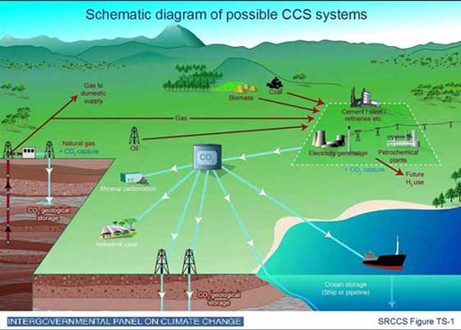
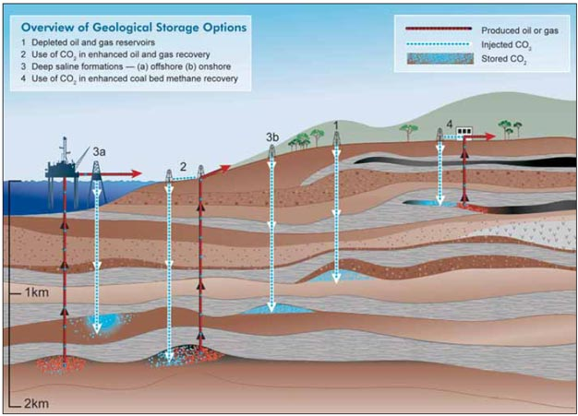
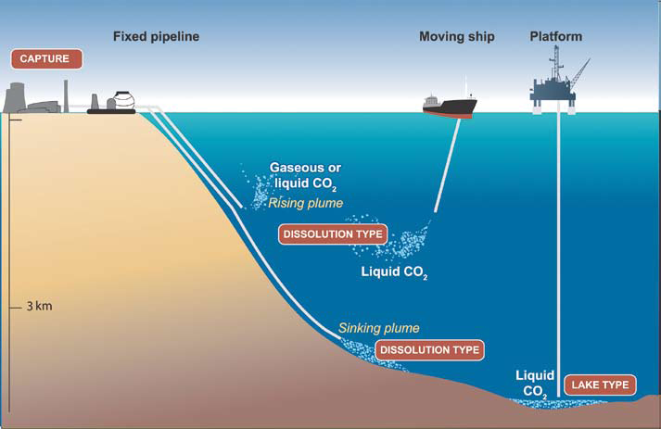
Carbon Capture and Storage
EG5066 Energy Technologies: current issues & future directions

Slide 2
EG5066 Energy Technologies: current issues & future directions

Slide 3
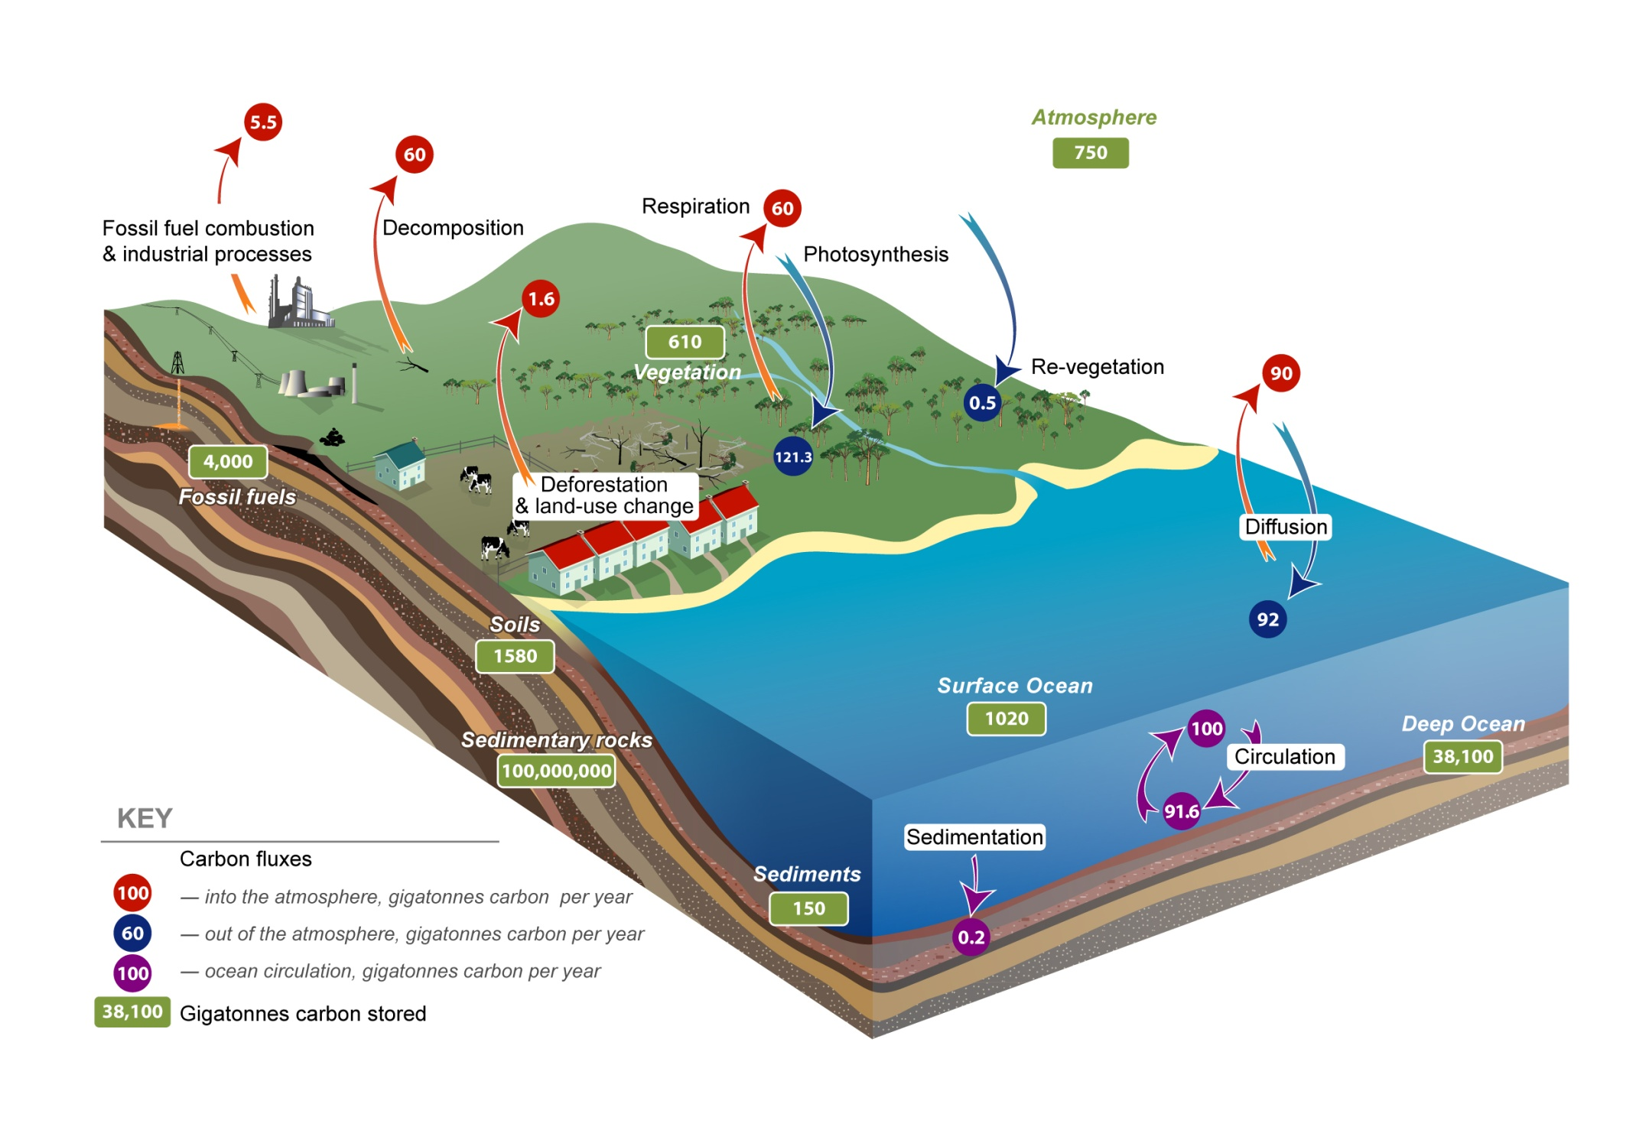
Carbon Capture and Storage
Source: CO2CRC
EG5066 Energy Technologies: current issues & future directions

Slide 4
Carbon Capture and Storage
Term mainly used to describe capturing CO₂ from flue gas emissions and storing it in geological structures or the oceans
Can also be used to describe biological processes which sequester CO₂ through photosynthesis – trees, plankton, algae
Another potential method is via burying biochar
Where biological processes are utilised the S in CCS refers to carbon sequestration rather than storage
EG5066 Energy Technologies: current issues & future directions

Slide 5
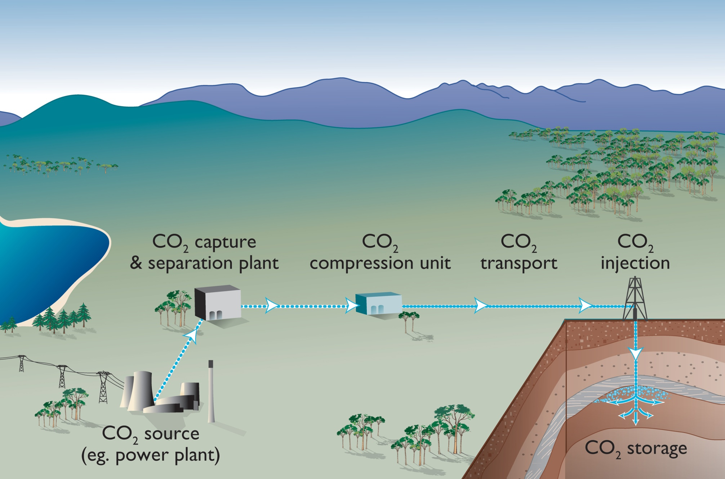
Carbon Capture and Storage
Three stages:
Capture
Transport
Storage
Source: CO2CRC
EG5066 Energy Technologies: current issues & future directions

Slide 6
Suitable CO₂ sources for Capture
CCS
Large stationary point source
High CO₂ concentration in the waste, flue gas or by-product stream (purity)
Pressure of CO₂ stream
Distance from suitable storage sites
EG5066 Energy Technologies: current issues & future directions

Slide 7
Global large stationary CO₂ sources with emissions of more than 0.1 MtCO₂/ year
Process |  | Number of sources | Emissions (MtCO₂ yr⁻¹)
Fossil fuels | Power | 4,942 | 10,539
 | Cement production | 1,175 | 932
 | Refineries | 638 | 798
 | Iron & steel industry | 269 | 646
 | Petrochemical industry | 470 | 379
 | Oil & gas processing | Not available | 50
 | Other sources | 90 | 33
Biomass | Bioethanol & bioenergy | 303 | 91
Total |  | 7,887 | 13,466
EG5066 Energy Technologies: current issues & future directions

Slide 8
Future CO₂ Sources
CCS
Global CO₂ emissions rising – projected to range from
2020 29 – 44 GtCO₂
2050 23 – 84 GtCO₂
Technical potential of CO₂ capture estimated at:
2020 2.6 – 4.9 GtCO₂ – around 10%
2050 4.7 – 37.5 GtCO₂ (20 – 40%)
Source: IPCC
EG5066 Energy Technologies: current issues & future directions

Slide 9
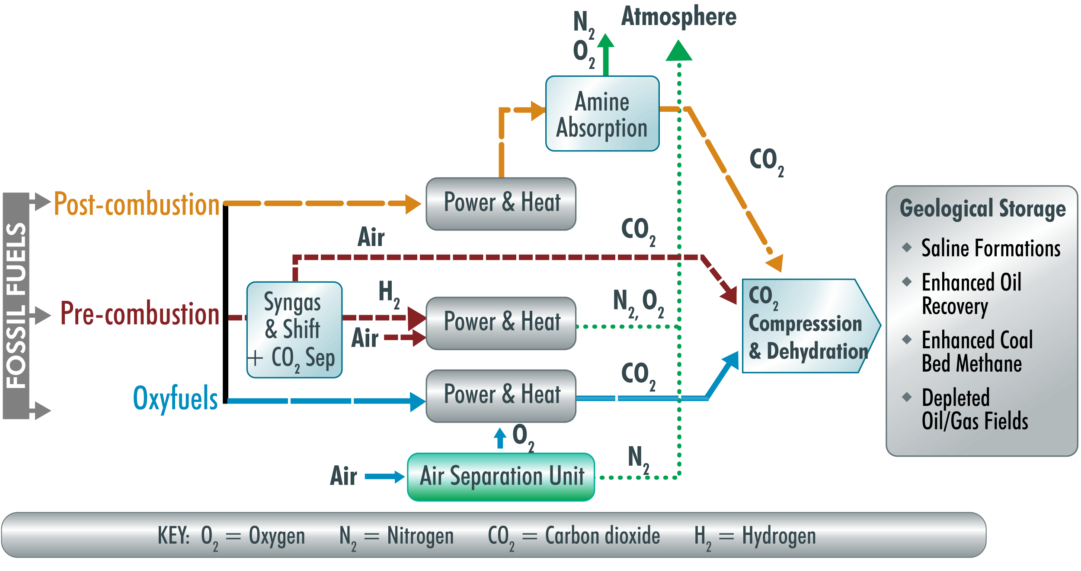
Carbon Capture Technologies
CCS
Three main technological solutions
Post-combustion capture
Pre-combustion capture
Oxyfuel combustion capture
EG5066 Energy Technologies: current issues & future directions

Slide 10
Carbon Capture & Storage
CO₂ Capture processes and systems
Concentration
Industrial Separation
Compression
Raw Material
CO₂ separation
CO₂
Industrial process
Product
Post-combustion
Compression
CO₂ separation
CO₂
3-15%
Combustion
Fossil fuels Biomass
Air
Heat & Power
Pre-combustion
Compression
H₂ &CO₂ separation
CO₂
15-60%
Gasification/reform
Air/O₂ + steam
H₂
Heat & Power
Other Products
Oxyfuel
Compression
Combustion
CO₂
95-99%
Source: IPCC
O₂ separation
Heat & Power
O₂
Air
Energy Industries Overview

Slide 11
Maturity of capture technology
CCS
Technology | Research | Demonstration | Economically feasible | Mature Market
Post-combustion |  |  | X
Pre-combustion |  |  | X
Oxyfuel combustion |  | X
Industrial separation |  |  |  | X
Source: IPCC
EG5066 Energy Technologies: current issues & future directions

Slide 12
Carbon Capture & Storage
Difference between
CO₂ captured and CO₂ emissions avoided
Emitted
Captured
Reference Plant
CO₂ avoided
CO₂ captured
With CCS
Source: IPCC
CO₂ produced (kg/kWh)
CO₂ capture may increase fuel needs of coal-fired plant by 25 – 40%
Energy Industries Overview

Slide 13
Post-Combustion Capture
CCS
Before CO₂ can be removed from flue gas first need to remove:
Particles – electrostatic precipitator
Contaminant gases such as SOx and NOx – flue gas desulpherisation
Particle and contaminant free flue gas passed through chemical sorbent (amine-based) which absorbs CO₂
Other methods – membranes or solid sorbents – not as efficient/cost effective
EG5066 Energy Technologies: current issues & future directions

Slide 14
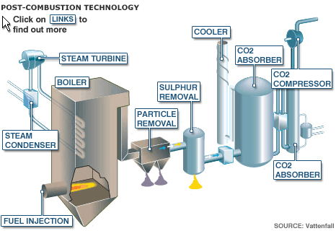
Post-Combustion Capture
CCS
Flue gas cooled & brought into contact with amine solution
CO₂ bound to amine solution & transported to stripper
Chemical reaction binding CO₂ with amine reversible
Amine solution regenerated in scrubber
Captured CO₂ compressed & dehydrated
EG5066 Energy Technologies: current issues & future directions

Slide 15
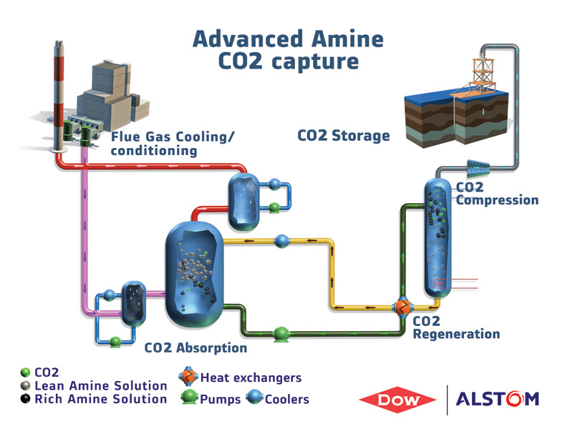
Post-Combustion Capture
CCS
Pros:
Feasible to retrofit to current industrial plants and power stations.
Existing technology - 60 years experience with amine solvents - but needs 10x scale-up.
Currently in use to capture CO₂ for soft drinks industry.
Cons:
High running costs – absorber and degraded solvents replacement.
Limited large scale operating experience.
EG5066 Energy Technologies: current issues & future directions

Slide 16
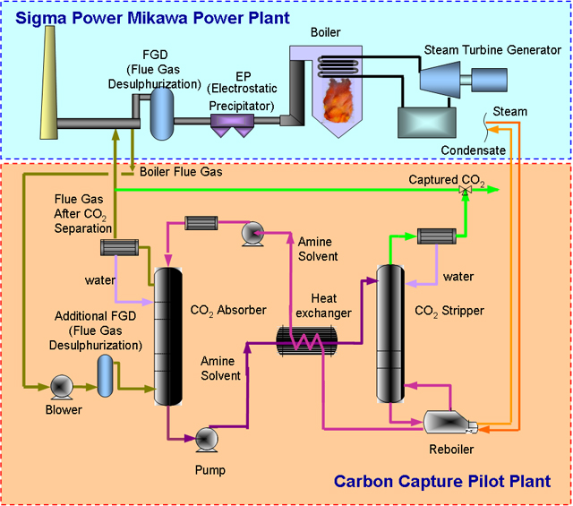
Post-Combustion Capture
CCS
EG5066 Energy Technologies: current issues & future directions

Slide 17
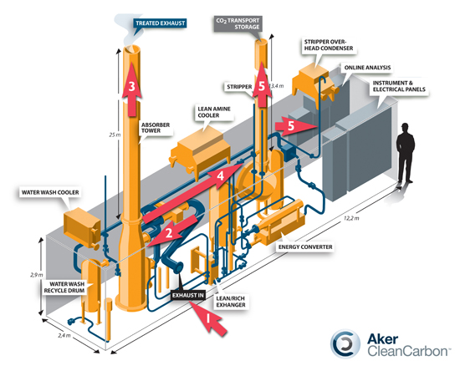
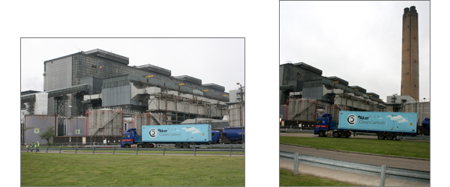
Carbon Capture & Storage
Post-Combustion Capture
Scottish Power - Longannet
Energy Industries Overview

Slide 18
Carbon Capture & Storage
Post-Combustion Capture
Flue gas cooled & brought into contact with amine solution
CO₂ bound to amine solution & transported to stripper
Chemical reaction binding CO₂ with amine reversible
Amine solution regenerated in scrubber
Captured CO₂ compressed & dehydrated
Energy Industries Overview

Slide 19
Carbon Capture & Storage
Post-Combustion Capture
Pros:
Feasible to retrofit to current industrial plants and power stations.
Existing technology - 60 years experience with amine solvents - but needs 10x scale-up.
Currently in use to capture CO₂ for soft drinks industry.
Cons:
High running costs – absorber and degraded solvents replacement.
Limited large scale operating experience.
Energy Industries Overview

Slide 20
Pre-combustion Capture
CCS
1st stage – to produce syngas (H₂ + CO)
Two routes:
Steam reforming – steam added to primary fuel
CxHy + xH₂O
xCO + (x + y/2)H₂
Partial oxidation of gaseous fuels (gasification)
CxHy + x/2O₂
xCO + (y/2)H₂
2nd stage water gas shift reaction to convert the CO into CO₂
CO + H₂O
CO₂ + H₂
EG5066 Energy Technologies: current issues & future directions

Slide 21
Pre-combustion Capture
CCS
Combined cycle power block
Electricity
Steam
O₂
CO₂
Capture
Gas & Steam Turbines
Clean syngas (H₂ + CO)
Coal
Biomass
Industrial wastes
Gasifier
H₂O & CO shift to H₂ & CO₂
H₂S removal
Hydrogen
Ammonia
F-T Liquids
H₂O
Sulphur recovery
Sulphur
Slag
EG5066 Energy Technologies: current issues & future directions

Slide 22
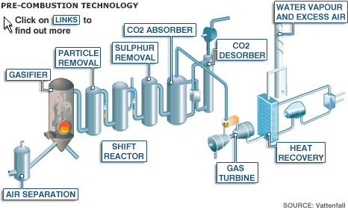
Pre-combustion Capture
CCS
Pros:
Proven industrial scale technology in oil refineries, but needs 3x scale-up for power plants.
90-95% of CO₂ emissions can be captured.
Applicable to natural gas, and to coal fired IGCC power plants.
Lowest technology risk, and may become the most efficient method.
Can produce H₂ as transportable energy vector, or liquid fuels from coal - but penalties on efficiency
Cons:
Requires a chemical plant in front of gas turbine
High investment cost of dedicated new-build plant.
High NOx emissions – will require expensive scrubbers.
Efficiency of H₂ burning turbines is lower than conventional turbines.
May be less flexible under varying electricity generation market requirement, so base load preferred
EG5066 Energy Technologies: current issues & future directions

Slide 23
CCS
Oxyfuel Combustion Capture
Eliminates nitrogen from the flue gas by combustion in pure oxygen or mixture of pure oxygen and flue gas so NOx production reduced
Combustion temperature of fuel in pure oxygen is too high so temp controlled by proportion of process heat being recycled back to combustion chamber
Combustion products mainly CO₂ + water vapour + O₂
Combustion products cooled to condense water vapour giving 80 – 98% CO₂ depending on process & fuel
Concentrated CO₂ compressed, dehydated, purified before transport & storage
EG5066 Energy Technologies: current issues & future directions

Slide 24
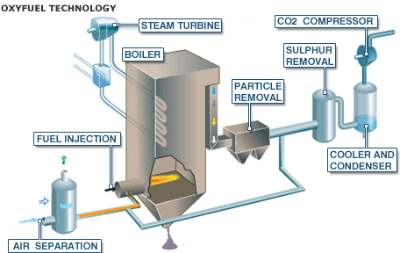
CCS
Oxyfuel Combustion Capture
Pros
Potential for 100% CO₂ capture.
Few other harmful emissions due to more complete combustion.
May be possible to retro-fit the oxy-fuel burners onto modified existing coal power plant
Cons
High energy penalty without chemical looping combustion.
Only at large development stage in 2007 - first Demonstration plants in planning
EG5066 Energy Technologies: current issues & future directions

Slide 25
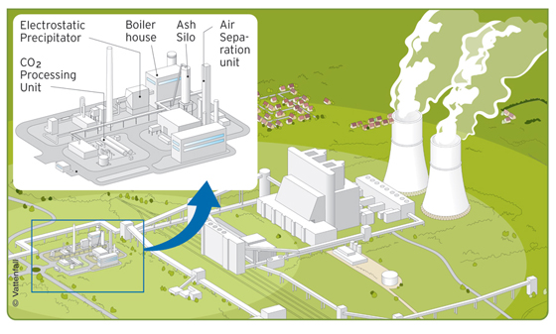
CCS
Oxyfuel Combustion Capture
Vattenfall demonstration plant - Schwarze Pumpe in Germany
30MW oxyfuel pilot plant attached to 1600MW lignite-fuelled power plant
90% CO₂ capture rate
EG5066 Energy Technologies: current issues & future directions

Slide 26
CCS
Chemical Looping Combustion
2 stage reaction of hydrocarbon combustion in 2 separate reactors:
Air (oxidiser) Reactor
Fuel (reducer) Reactor
Depleted Air
N₂, O₂
Combustion Products
CO₂, H₂O
*Fuel burns in reducer therefore does not come into contact with air and avoids need for post-combustion capture
Air Reactor
(Oxidiser)
MeO
Fuel Reactor
(Reducer)
Uses metal oxide as a hydrogen carrier
Metal particles reacted with air to give metal oxide
Metal oxide particles react with fuel on fluidised bed reactor to produce:
Metal particles
CO₂ and water vapour
Water vapour condensed leaving pure CO₂
Me
Air
Fuel
EG5066 Energy Technologies: current issues & future directions

Slide 27
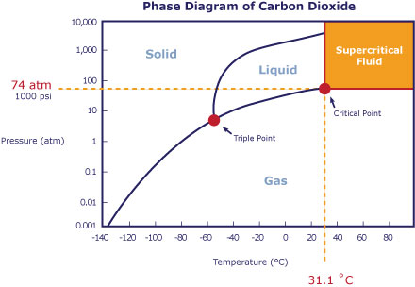
CCS
Transport
The main complication with CO₂ transport is that CO₂ behaves differently under varying pressures and temperatures and therefore transport of CO₂ must be carefully controlled to prevent solidification and blockages occurring.
At temperatures & pressures higher than the critical point CO₂ is in a supercritical state where it behaves as a gas but has a very high density similar to that of water
Pressure - 74 bar
Temperature - 31ºC
Two main methods:
Pipeline
Ship
EG5066 Energy Technologies: current issues & future directions

Slide 28
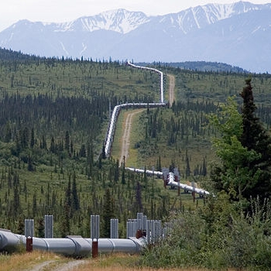
Transport by pipeline
CCS
Common in USA – in 2008 there were some 5800km of CO₂ pipelines used since 1970s for EOR projects
Designed for supercritical/dense phase CO₂ transport.
Avoids solidification of the CO₂ and to be pumped as a liquid.
Pressures are kept above 10 MPa
CO₂ must be dried before transportation because:
CO₂ dissolved in water creates an acidic solution that attacks metal pipelines.
CO₂ hydrate crystals can form when CO₂ and water mix causing pipeline blockages
EG5066 Energy Technologies: current issues & future directions

Slide 29
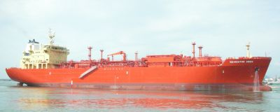
CCS
Ship Transport
Limited to food & brewing industry – 100, 000 tonnes/y
Similar to Liquefied Petroleum Gas (LPG)
Liquid CO₂ at -25 to -35ºC; pressures of 1.4 to 1.7 Mpa
Carry 850 to 1,400 t CO₂
Need more carrying capacity to make difference
EG5066 Energy Technologies: current issues & future directions

Slide 30
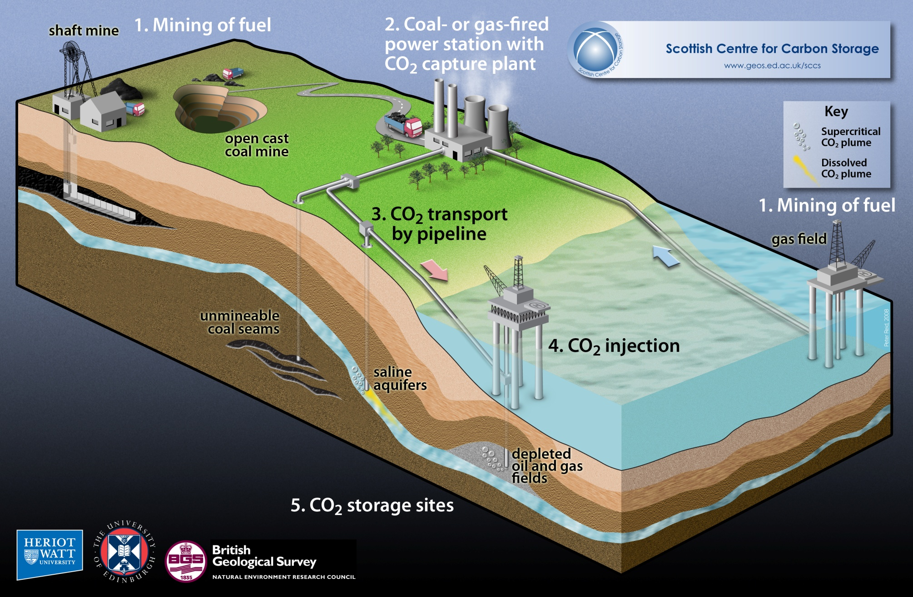
CCS

Slide 31
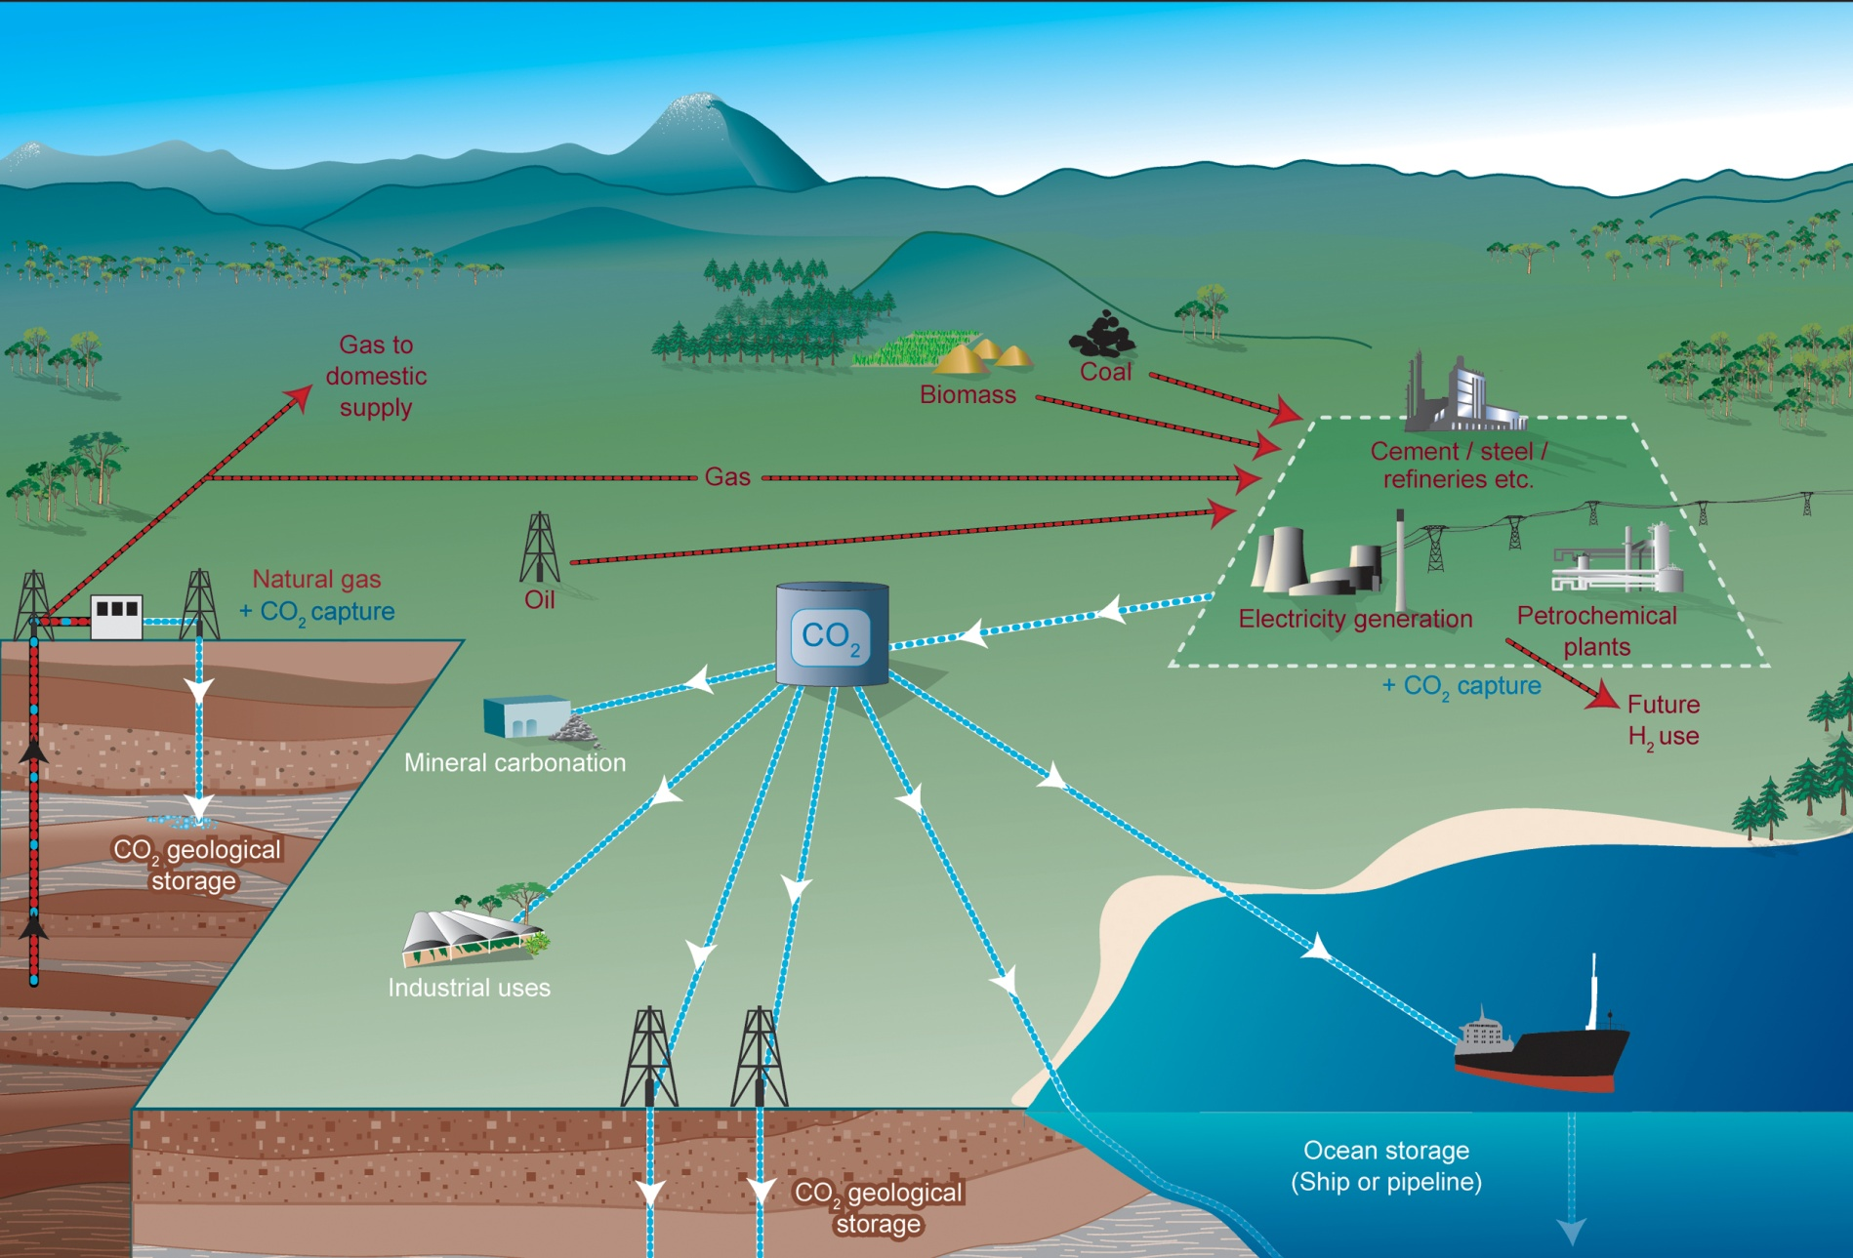
CCS
Source: CO2CRC
EG5066 Energy Technologies: current issues & future directions

Slide 32
Storage
CCS
Geological
Geological storage capacity at least 2,000 GtCO₂ mainly in oil and gas fields and in formations bearing saline water
Upper limit uncertain, especially in saline formations
Specific site characteristics need closer evaluation
CO₂ injection and reservoir engineering technology for depleted oil & gas fields and saline formations is mature and available
Monitoring of subsurface movement of CO₂ is being successfully conducted at several sites
EG5066 Energy Technologies: current issues & future directions

Slide 33
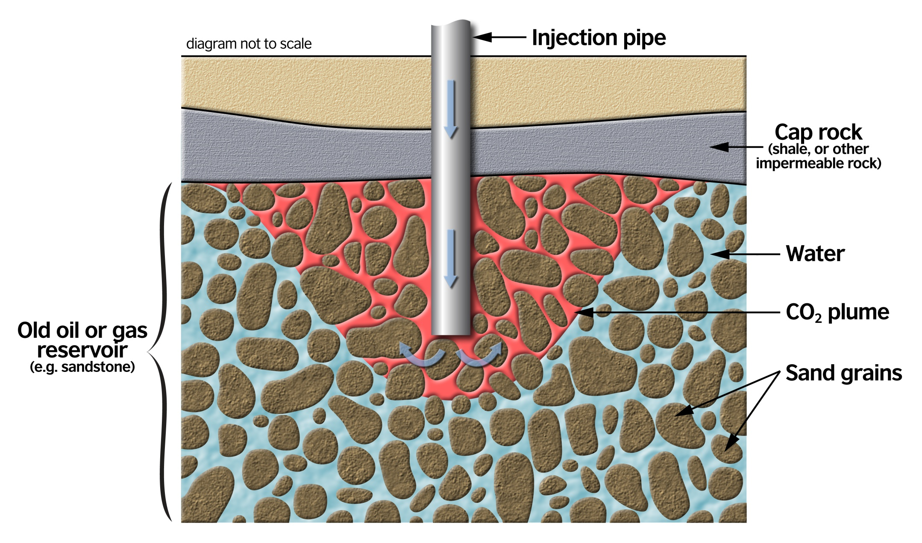
Carbon Capture & Storage
Basic Criteria for CO₂ Geological Storage Site
Reservoir – good porosity and permeability. Usually sandstone but can be carbonate
Seal/caprock – low permeability, low porosity, preferably unfractured. Usually a salt of shale
Structural closure (although not essential)
Formation below 800m – CO₂ exists in its dense phase
Geologically stable area
Energy Industries Overview

Slide 34
Carbon Capture & Storage
Storage
Source: IPCC
Energy Industries Overview

Slide 35
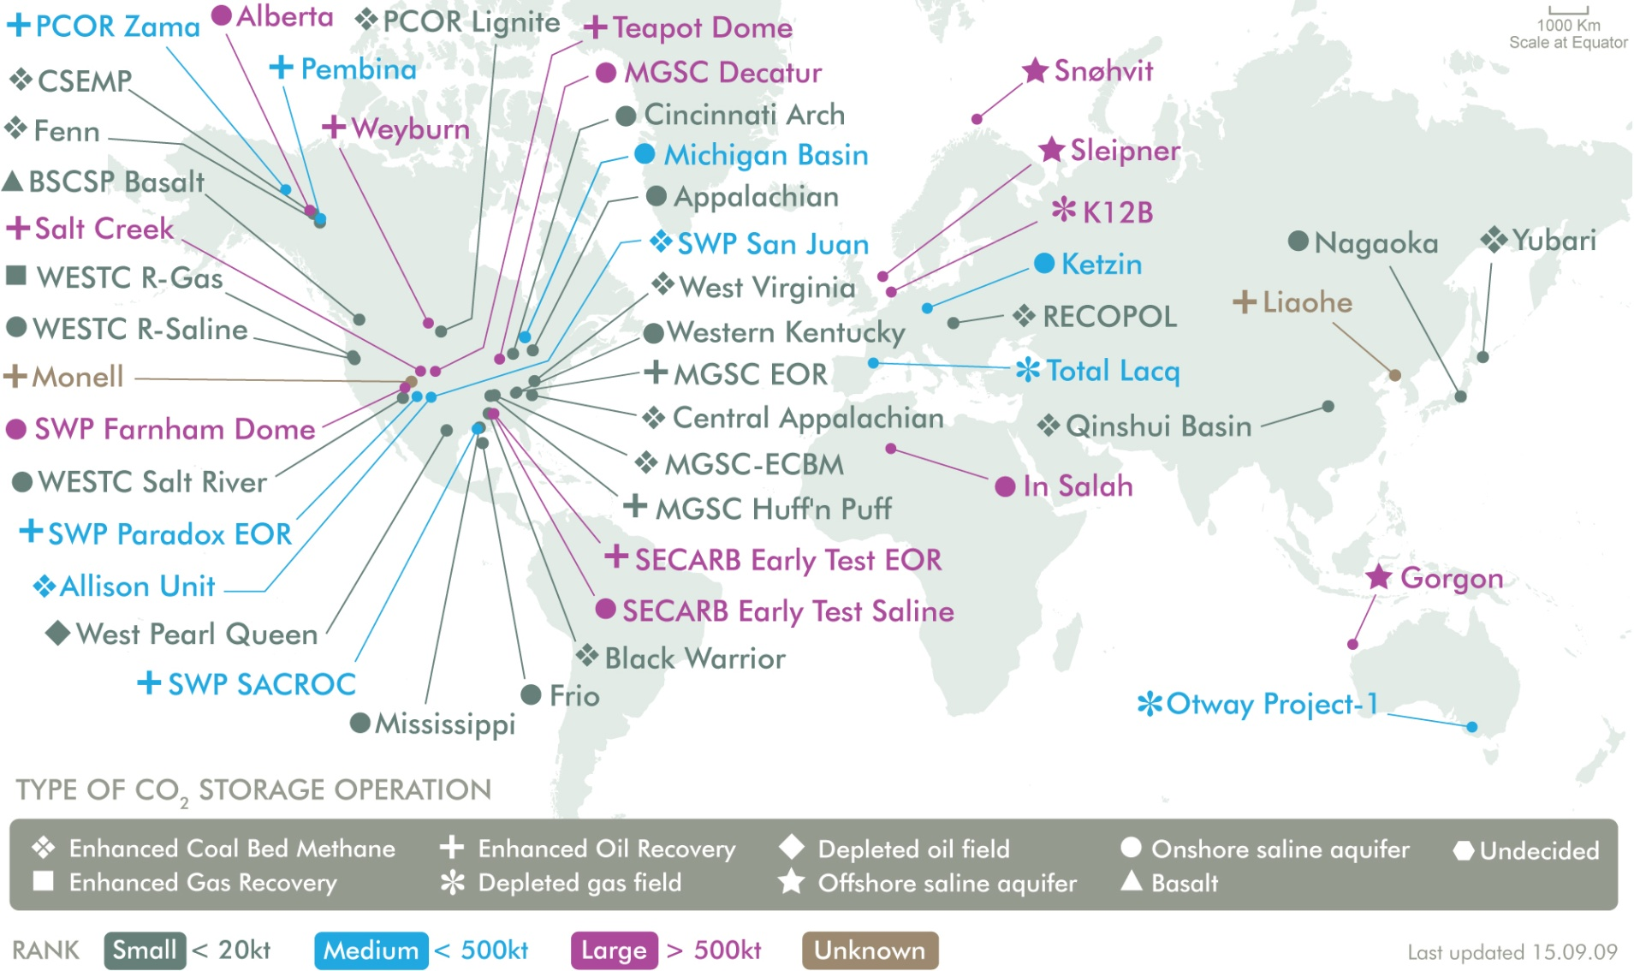
Storage
CCS
EG5066 Energy Technologies: current issues & future directions

Slide 36
Examples of CCS Projects
CCS
Project name | Country | Injection start (year) | Approximate average daily injection rate (tCO₂ day⁻¹) | Total (planned) storage (tCO₂) | Storage reservoir type
Weyburn | Canada | 2000 | 3,000-5,000 | 40,000,000 | EOR
In Salah | Algeria | 2004 | 3,000-4,000 | 17,000,000 | Gas field
Sleipner | Norway | 1996 | 3,000 | 20,000,000 | Saline formation
Snøhvit | Norway | 2006 | 2,000 | unknown | Saline formation
Note all separating CO₂ from natural gas or lignite-fired gasifier (Weyburn)
EG5066 Energy Technologies: current issues & future directions

Slide 37
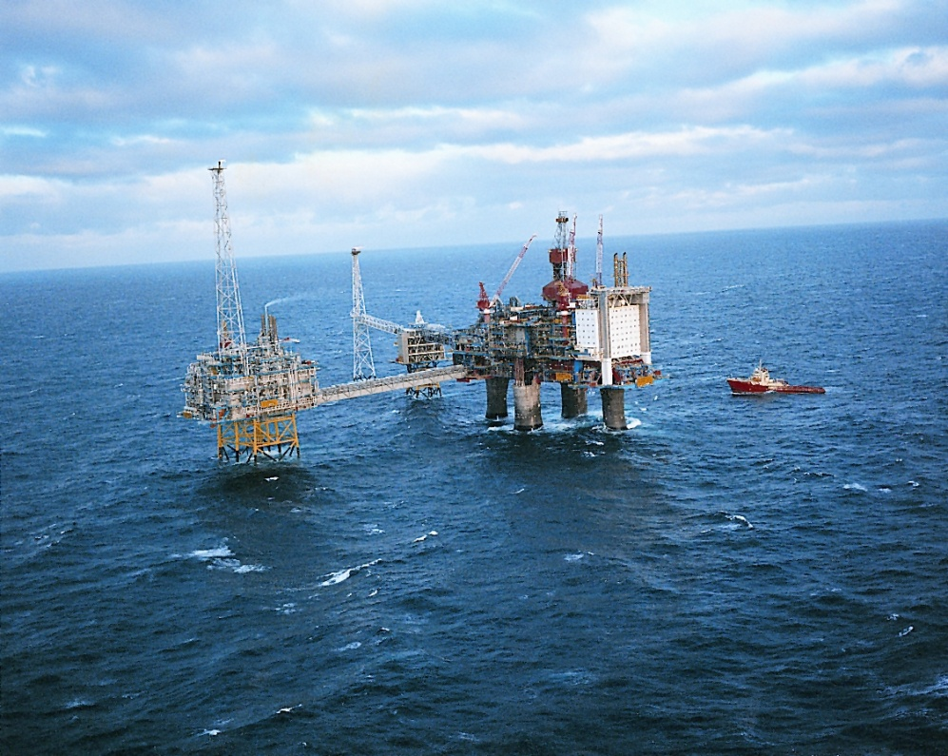
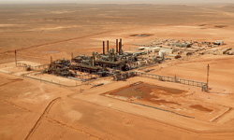
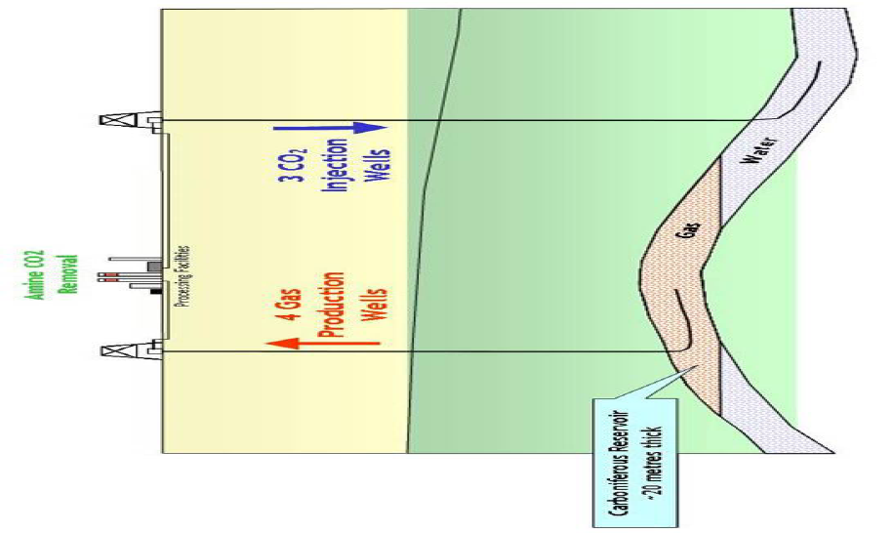
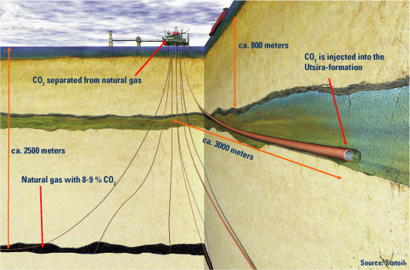
CCS
Sleipner - Norway
Krechba gas production plant - Algeria
EG5066 Energy Technologies: current issues & future directions

Slide 38
Storage - Ocean
CCS
Ocean Storage – proposed solution but it will make them more acidic and now no longer consider viable
EG5066 Energy Technologies: current issues & future directions

Slide 39
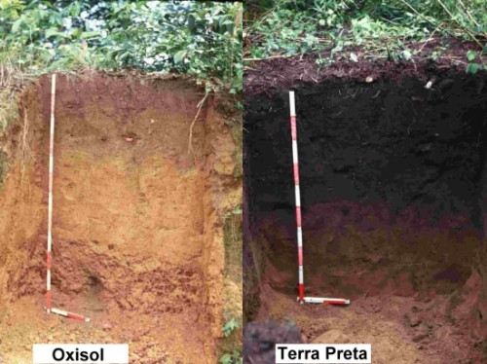
Biochar
CCS
Carbon-rich product of thermal decomposition of biomass under limited oxygen supply and relatively low temperatures (<700ºC)
Similar to charcoal, but produced to improve soil productivity and C storage
Can sequester carbon in soil for hundreds of thousands of years
Promoted by James Hansen & James Lovelock to mitigate GHG emissions
Pre-Columbian Amazonian Natives used biochar to enhance soil productivity – so-called Terra Preta de indio
Used a pit or trench method to produce biochar resulting in terra preta or dark soil
EG5066 Energy Technologies: current issues & future directions

Slide 40
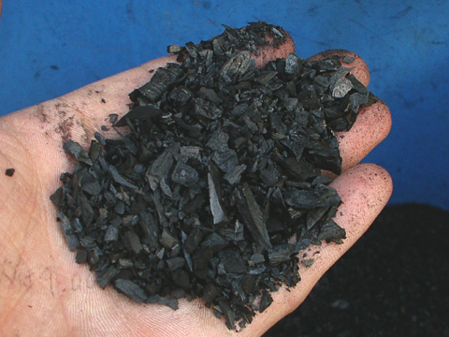
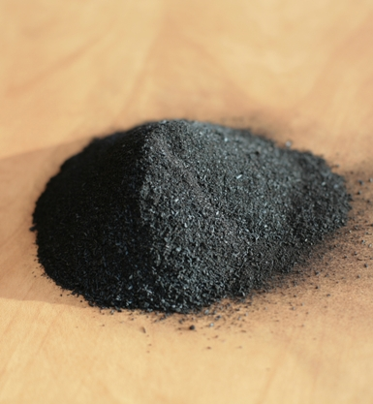
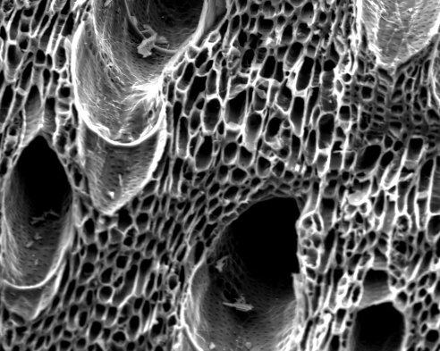
CCS
Biochar - characteristics
High carbon content (60 – 95% C)
Resistant to biodegradation
Significant adsorptive qualities (similar to activated carbon)
Nutrients (& contaminants) essentially lock on to the structure
Increases moisture holding capacity
Enhances microbial biomass
EG5066 Energy Technologies: current issues & future directions

Slide 41
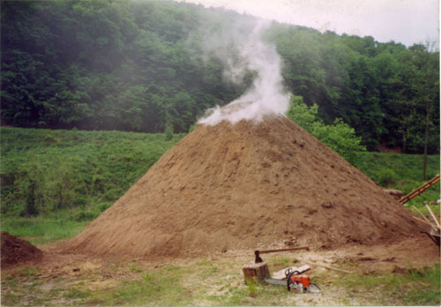
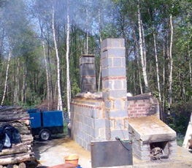
CCS
Biochar - production
Original method was to produce a soil additive in the pit or trench method
Modern method involves pyrolysis:
Fast pyrolysis (seconds) yields 60% bio-oil; 20% char, 20% syngas
Slow pyrolysis (hours) gives ~50% char – uses the syngas as fuel
The lower the temperature the more biochar produced
EG5066 Energy Technologies: current issues & future directions

Slide 42
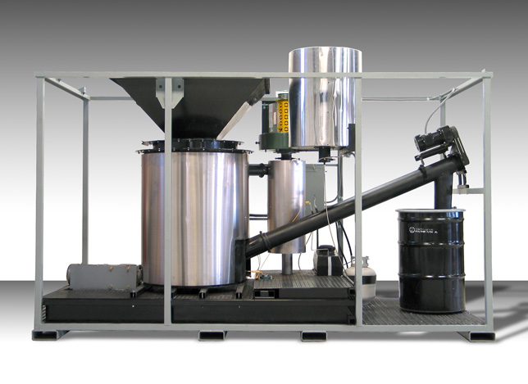
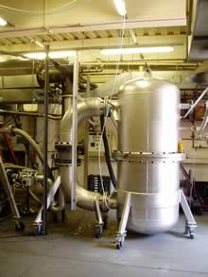
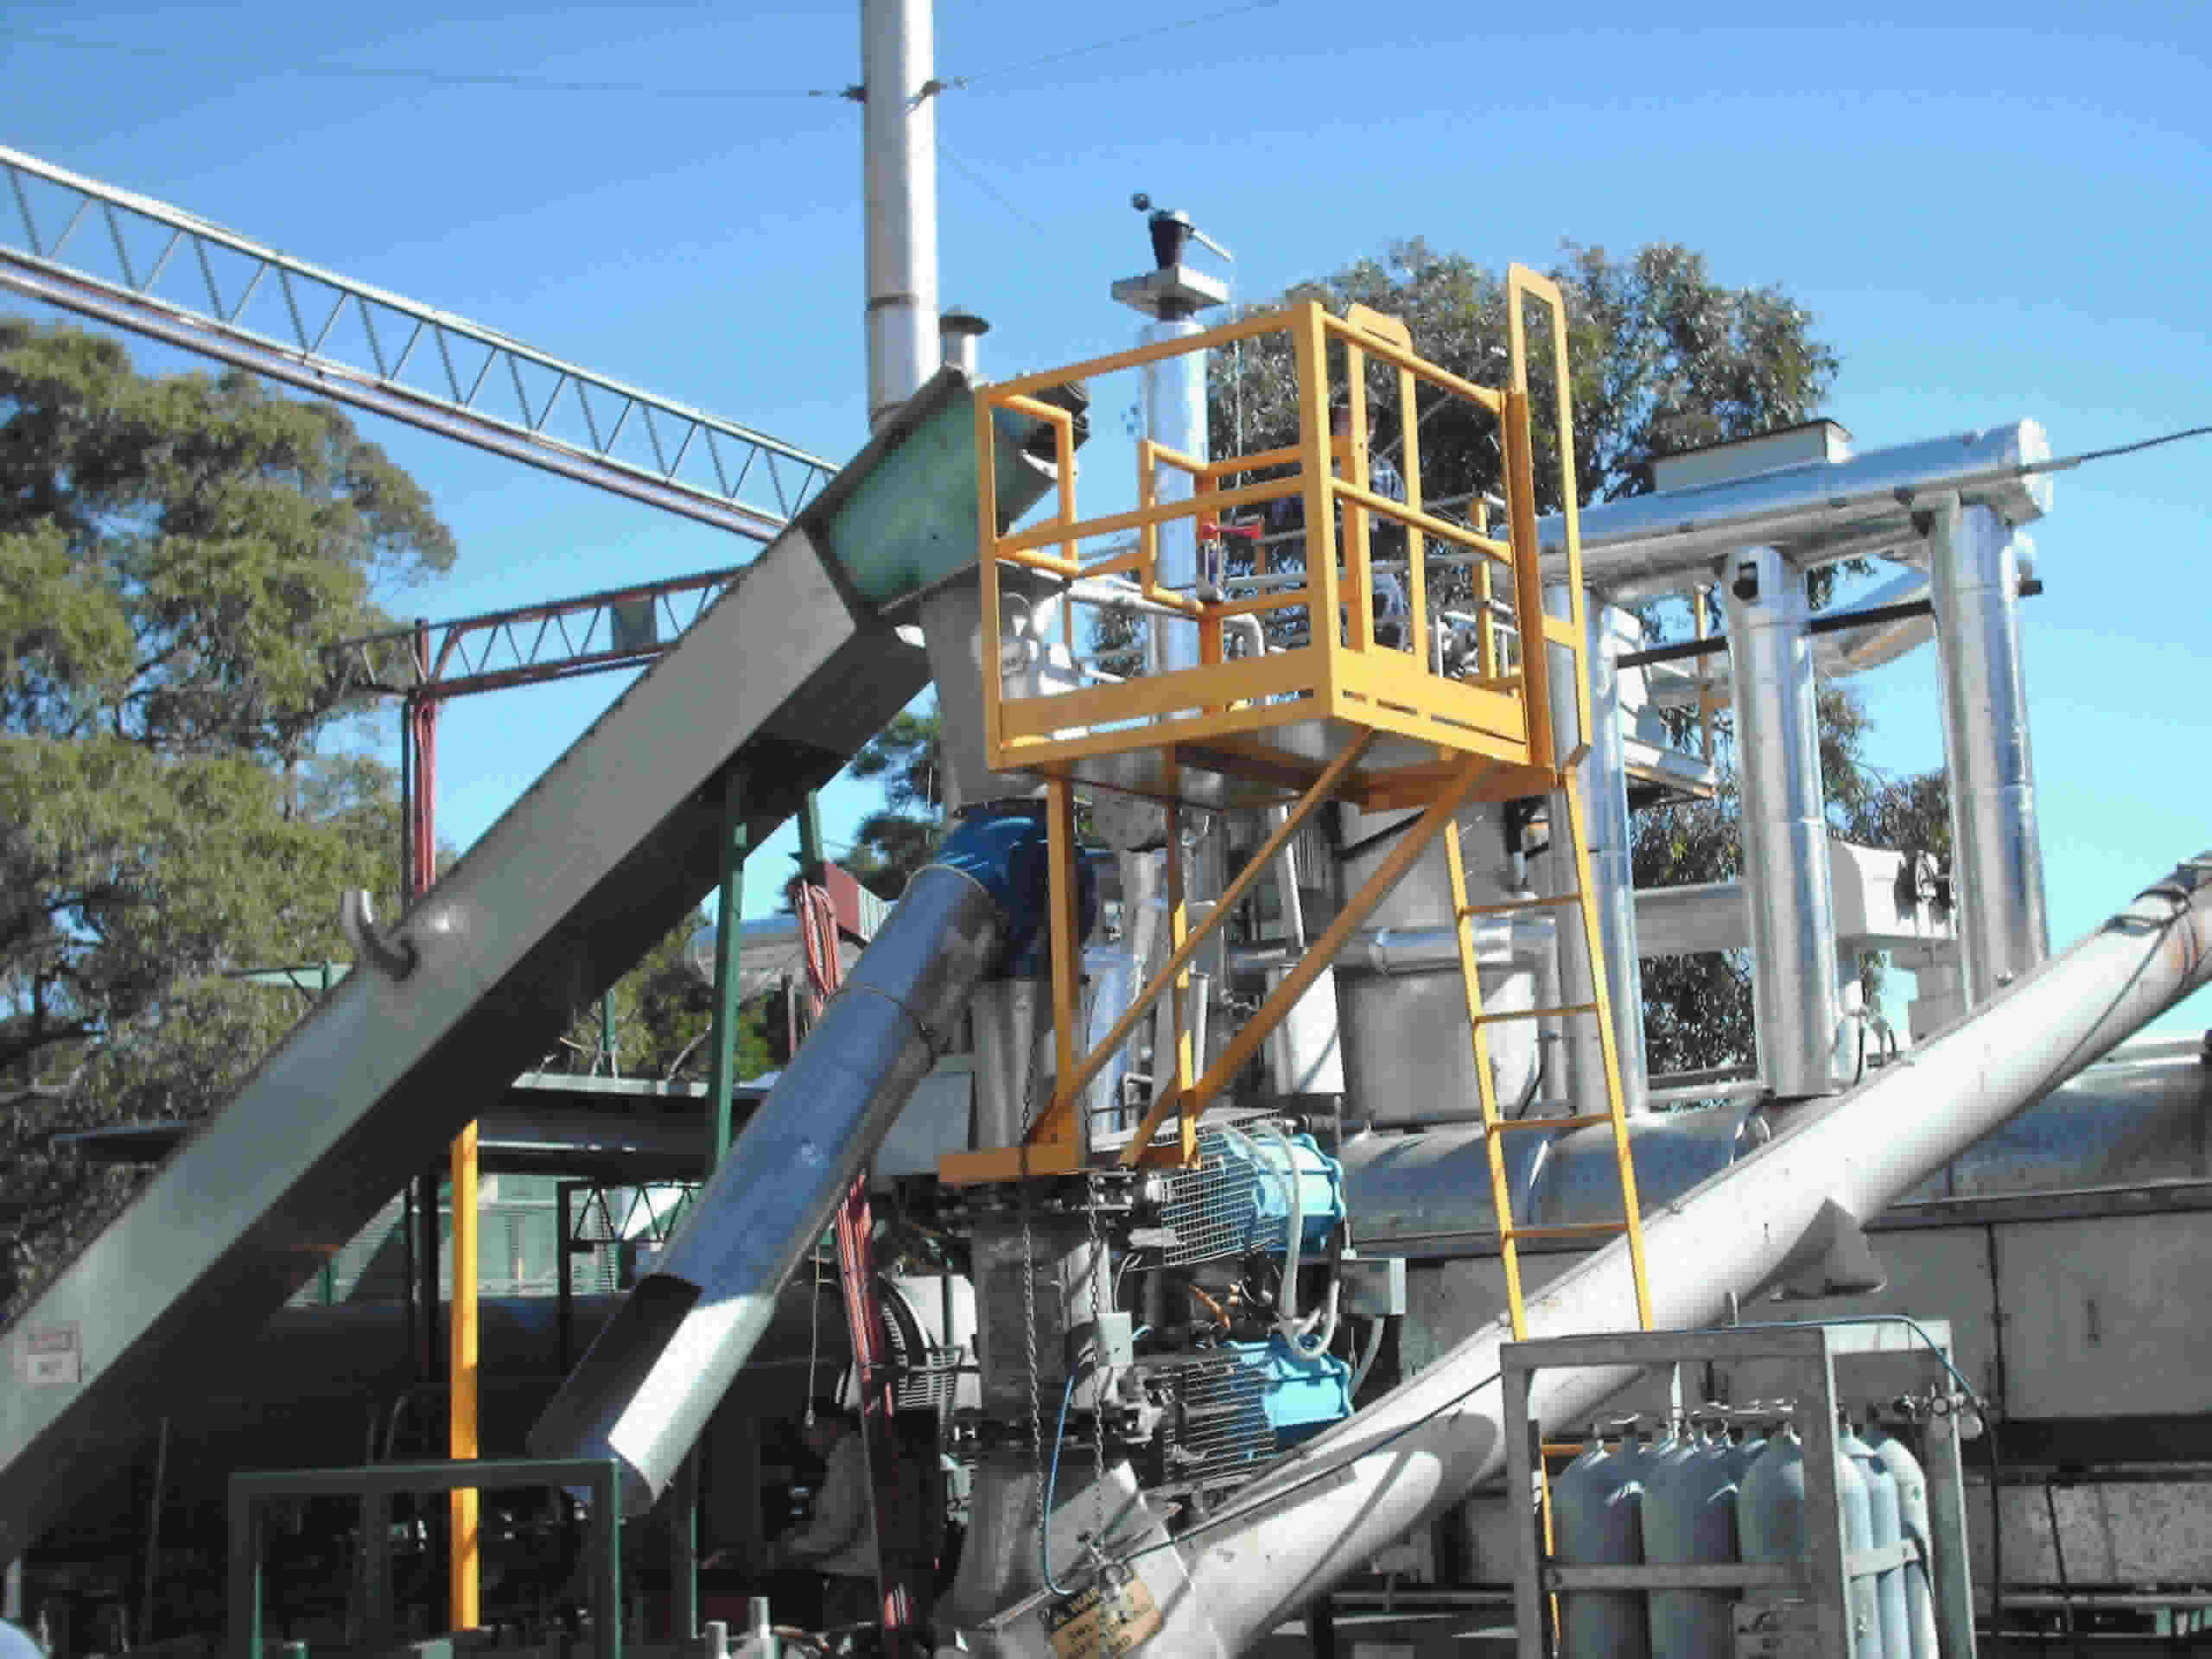
CCS
Biochar - production
As temperature increases:
Biochar yield decreases
Fixed carbon increases
Surface area increases
Ash content increases
EG5066 Energy Technologies: current issues & future directions

Slide 43
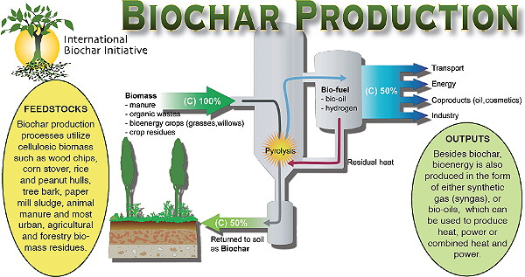
CCS
EG5066 Energy Technologies: current issues & future directions

Slide 44
Carbon Capture and Storage
Energy Industries Overview

